Slide 1

Microsoft Azure Well-Architected Framework <team_name>

Slide 2
WAF Journey
Establish the rhythm of the architecture review and plan each day. Example:
Day 1 (Meetings)
Quick-off meeting
Day 2 (Meetings)
Finish survey
Day 3 (Offline work)
Analyze data
Day 4 (Offline)
Day 5 (Meetings)
Prioritize recommendations
Present recommendations
Start assessment survey
Subscription Walkthrough
Gather additional data with CCODashboard
Review recommendations
Create the roadmap
Discuss and reprioritize
Define next steps (short term)

Slide 3
Step 1- Describe the workload

Slide 4
Workload status
<Describe current status you can use a mindmap, description, bullets, etc highlights your top of mind for the scenario>
https://en.wikipedia.org/wiki/Mind_map
https://en.wikipedia.org/wiki/User_journey
https://businessmodelanalyst.com/value-proposition-canvas/

Slide 5
Stakeholder analysis - RACI
<Teams and people that need to be involved, why you think they need to be there and when will they participate>
Phase/Stakeholder | CTO | Teamleads | Solution Owner | Project Manager | Developers | Infrastructure Architect | Data Architect | Security Architect | Network Architect | Others…
Discover
Analyze
Prioritize
Optimize
R = Responsible, A = Accountable, C = Consulted, I =Informed

Slide 6
Step 2- Information collection

Slide 7
Tools to use
<Include a list of tools and techniques you will use to gather information>
Azure Tools
3rd Party
Custom Built
Procedure/Meetings

Slide 8
Step 3- Cost Optimization

Slide 9
Cost Optimization checklist -IaaS
<changes in configuration, sizing, or billing to be implemented to improve costs in current deployment>

Slide 10
Cost Optimization checklist -IaaS
<List of operational changes to be implemented to keep track of costs>

Slide 11
Cost Optimization checklist -IaaS
<Impact of your cost recommendations, use the pricing calculator with the current deployment estimate as your starting point https://azure.com/e/1a6d9fb988714fb5bc4153c0bcc178e5 >

Slide 12
Step 4- Security

Slide 13
Security
<List of security practices to be in place for all topics>
Identity
RBAC
Encryption
Networking
Secrets & Keys
Tools & Processes

Slide 14
Security
<High Level Architecture including security best practices>

Slide 15
Step 5- Reliability

Slide 16
Reliability Recommendations
<List of reliability recommendations to be implemented>

Slide 17
High Level architecture for IaaS

Slide 18
High Level architecture for PaaS

Slide 19
Estimation of your solution SLA
IaaS
%
PaaS
%
https://docs.microsoft.com/en-us/azure/architecture/framework/resiliency/business-metrics#composite-slas

Slide 20
Step 6- Performance Efficiency

Slide 21
Describe how your application scales
<List of services and solutions that will allow you to improve performance and scalability>

Slide 22
Metrics and tooling changes to scale
<List of tooling that will need to be in place to meet demand and support the new architecture>

Slide 23
Step 7- Operational Excellence

Slide 24
Operational Excellence
Monitoring
Resources
Deployment
Testing
BCDR
[Text
[Text
[Text
[Text
<List of best practices to be implemented for operations>

Slide 25
Operational Excellence
<Tooling and methodologies needed to support those best practices>

Slide 26
Step 8- Create a plan

Slide 27
Checklist
Production disruption
Time estimations
People involved*
Potential risks
Success metrics
* You should have already discussed this in step 2 – RACI (prioritize – optimize)

Slide 28
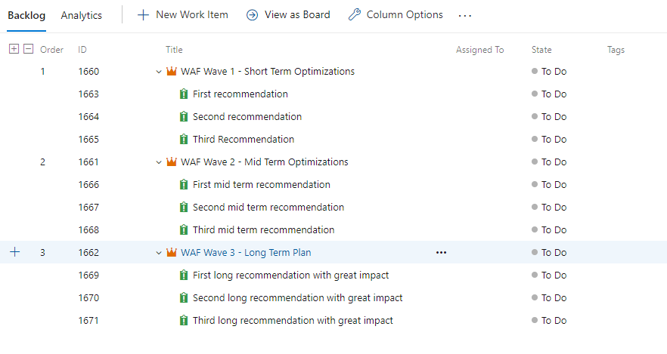
Roadmap or Backlog with prioritized recommendations
<Short term recommendations should be short and immediately actionable>
Short term (2 weeks)
Most
Mid Term (2 months)
Second
Long Term (1 year)
Relevant
Important
and
Actionnable
Recommendations
Level
Recommendations
but
Complex
Actions

Slide 29
Proposed mid/long-term architectures

Slide 30
Step 9- Deliverables
Notes:
Extra ball

Slide 31
List the derivelables

Slide 32
Apendix

Slide 33
Resources
Azure Well-Architected Framework documentation​ ​
Microsoft Learn course​ ​
Architecture center​
​
Azure Security Benchmark​
​​
Azure Well-Architected Review​
​
CCO Dashboard​
​
AzGovViz​ ​
Cloud adoption Framework tools

Slide 34
Thank you.

